Slide 1
Urban Noise and Educational Outcomes
Analyzing Environmental Sound Impacts in NYC Schools
Emily Aiken

Slide 2
Project Overview
Context
NYC schools operate in a complex urban environment with diverse noise sources
Over 1,800 schools serving 1.1 million students
Previous studies haven't examined different noise types' specific impacts
Success Metrics
Model performance (Strong CV score, F1 score, and accuracy)
Identification of most influential noise factors
Clear patterns in noise-achievement relationships
Notes:
Context
NYC schools operate in a complex urban environment
Multiple overlapping noise sources: traffic, construction, emergency vehicles
Schools often near major transportation routes
Mix of residential and commercial areas
Dense urban infrastructure affects noise patterns
Diverse neighborhood characteristics
Over 1,800 schools serving 1.1 million students
Largest public school system in US
Wide range of building types and ages
Varied proximity to noise sources
Diverse student population
Different grade levels and programs
Previous studies haven't examined different noise types
Past research focused on overall noise levels
Lacked differentiation between noise sources
Didn't consider timing of different noises
Missing analysis of specific impacts
Gap in understanding noise type effects
Success Metrics
Model performance
Cross-validation score of 0.892 shows robust performance
F1 Score of 0.916 indicates balanced predictions
Accuracy of 0.91 demonstrates reliable results
Consistent performance across different data subsets
Outperformed alternative models tested
Identification of most influential noise factors
Alert signals showed positive correlation (1.530)
Engine noise had moderate positive impact (1.067)
Music showed strong negative correlation (-2.080)
Dog presence negatively correlated (-1.581)
Clear hierarchy of noise impacts emerged
Clear patterns in noise-achievement relationships
Stronger effects in elementary grades
Consistent patterns across schools
Geographic variations identified
Temporal patterns emerged
Results align with practical observations

Slide 3
Project Framework
Key Stakeholders
School administrators and teachers
Urban planners and policymakers
Department of Education
Students and Families
Project Constraints
Availability of recent historical data only
Environmental factors beyond our control (weather, construction, events)
Cannot establish direct causation; only correlation
Notes:
Key Stakeholders
School administrators and teachers
Front-line implementers of any noise reduction strategies
Direct observers of noise impact on learning
Responsible for balancing academic needs with environmental challenges
Key role in monitoring intervention effectiveness
Need practical, implementable solutions
Urban planners and policymakers
Shape future school building requirements
Influence zoning decisions around schools
Control infrastructure budgets
Can create noise-related regulations
Balance multiple community needs
Department of Education
Sets system-wide policies
Controls funding allocation
Establishes testing schedules
Can mandate noise reduction measures
Responsible for overall student achievement
Students and Families
Directly affected by noise impacts
Can provide valuable feedback
May need to adapt to interventions
Important partners in implementation
Success ultimately measured by their outcomes
Project Constraints
Availability of recent historical data only
Limited to 2016-2019 timeframe for reasons I will discuss later
Cannot analyze long-term trends
May miss historical patterns
However, recent data ensures relevance and captures current urban conditions
Environmental factors beyond our control
Weather affects noise patterns
Construction projects arise unexpectedly
Community events impact noise levels
Emergency vehicle routes cannot be changed
Seasonal variations in noise sources
Cannot establish direct causation
Multiple factors influence academic performance
Noise is one of many environmental variables
Complex urban environment
Need to consider socioeconomic factors
Statistical relationships show correlation only

Slide 4
Datasets Used
Sounds of New York City (SONYC) Dataset
Acoustic data for over 18,000 annotated sound recordings taken in NYC between 2016 and 2019 with associated spatiotemporal metadata
Project run by New York University and made possible by volunteers
Each sound is classified into one of 8 different categories
New York City Public Schools Performance Data
School quality reports from grades K-8 and high school
Used reports for academic years 2016-17 through 2018-19
NYC Open Data School Point Locations
ESRI shapefile with each school’s coordinates
Notes:
SONYC Dataset
CSV file consisting of annotations for over 18,000 unique .WAV recordings from 54 sensors throughout New York City
Each annotation contains detailed spatiotemporal metadata including sensor coordinates and timestamps for each recording
Project run by New York University and made possible by volunteers
Volunteers place sensors on their property
These sensors turn on and make recordings when sounds are over a certain decibel level
A separate group of volunteers identifies sounds in the dataset and classifies them into a label taxonomy.
Label taxonomy consists of 8 categories, and each category has between 1 and 5 subcategories. Categories include:
Engine, machinery-impact, non-machinery-impact, powered-saw, alert-signal, music, human-voice, and dog
New York City Public Schools Performance Data
NYC Public Schools releases annual school quality reports that contain demographic data, attendance information, and standardized test performance on each school in the public school system
Two different school quality reports: One for grades K-8 and one for high schools
Used school quality reports spanning the academic years from 2016-17 through 2018-19 due to temporal constraints on the SONYC data
NYC Open Data School Point Locations
ESRI shapefile containing geospatial data with precise school locations across all boroughs of New York City

Slide 5
Data Wrangling and Key Takeaways
Combined data from three distinct sources
SONYC dataset’s 23 sound classes were aggregated into broader categories
Addressed data quality through temporal alignment, spatial validation, and consistency checks
Notes:
Combined data from three distinct sources: SONYC acoustic sensors, NYC school performance reports, and school location data.
SONYC dataset required considerable cleaning
Needed to put dates into a usable format since each annotation was marked with week of the year and day of the week.
Due to the complicated label taxonomy of the audio annotations, the SONYC dataset had 23 distinct sound classes.
Subcategories were ignored in favor of their broader categories, simplifying 23 sound classes down to 8.
After cleaning, I needed to eliminate schools from our analysis that were not covered by our sensor ranges.
Using the combined dataset, I used GeoPandas to identify schools within 2km of each sensor.
I also addressed data quality through temporal alignment (matching school years with noise recordings), spatial validation (verifying school coordinates), and consistency checks (removing duplicates, confirming school identifiers).

Slide 6
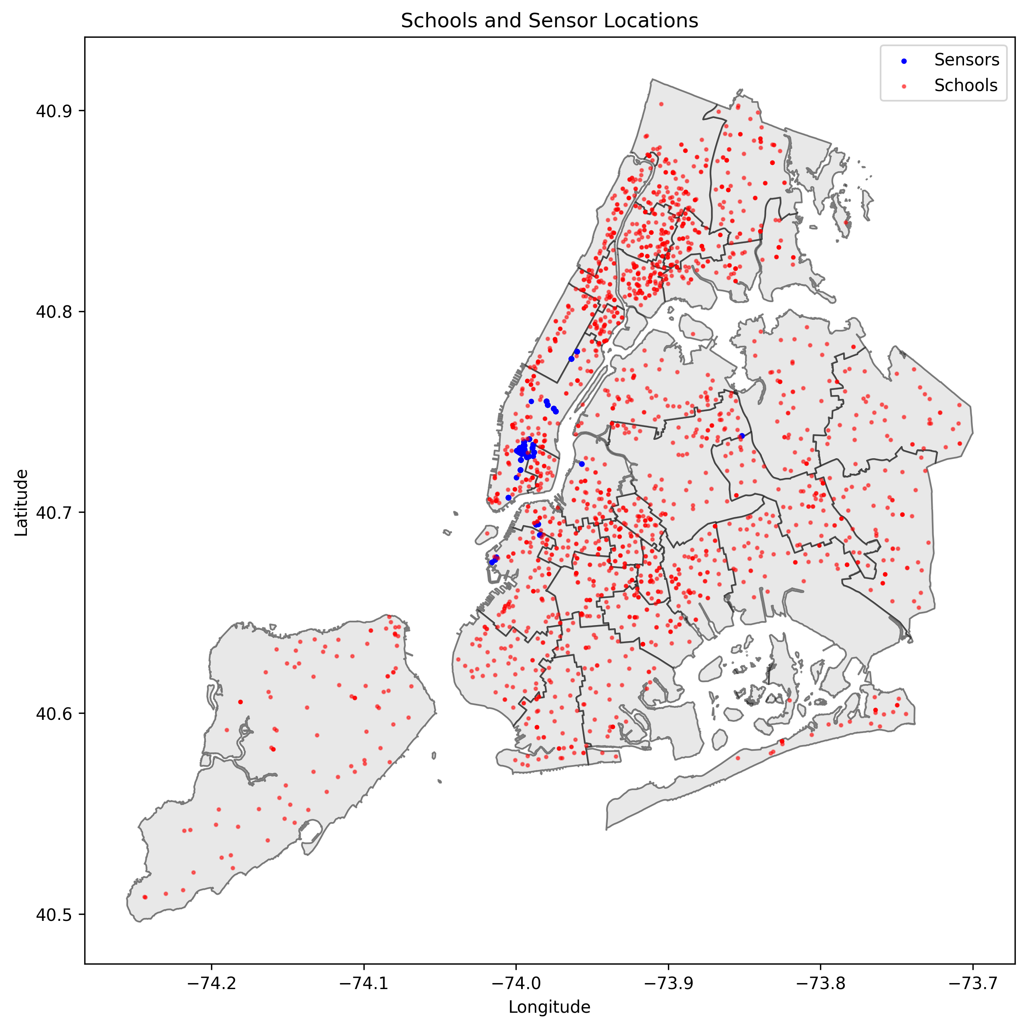
Notes:
Here is a map of all 54 sensors and all 1,950 schools in New York City, before any wrangling took place.
Sensors are marked by blue points and schools are marked by red.
As you can see, the sensors are mostly concentrated in one area of New York City. So…

Slide 7
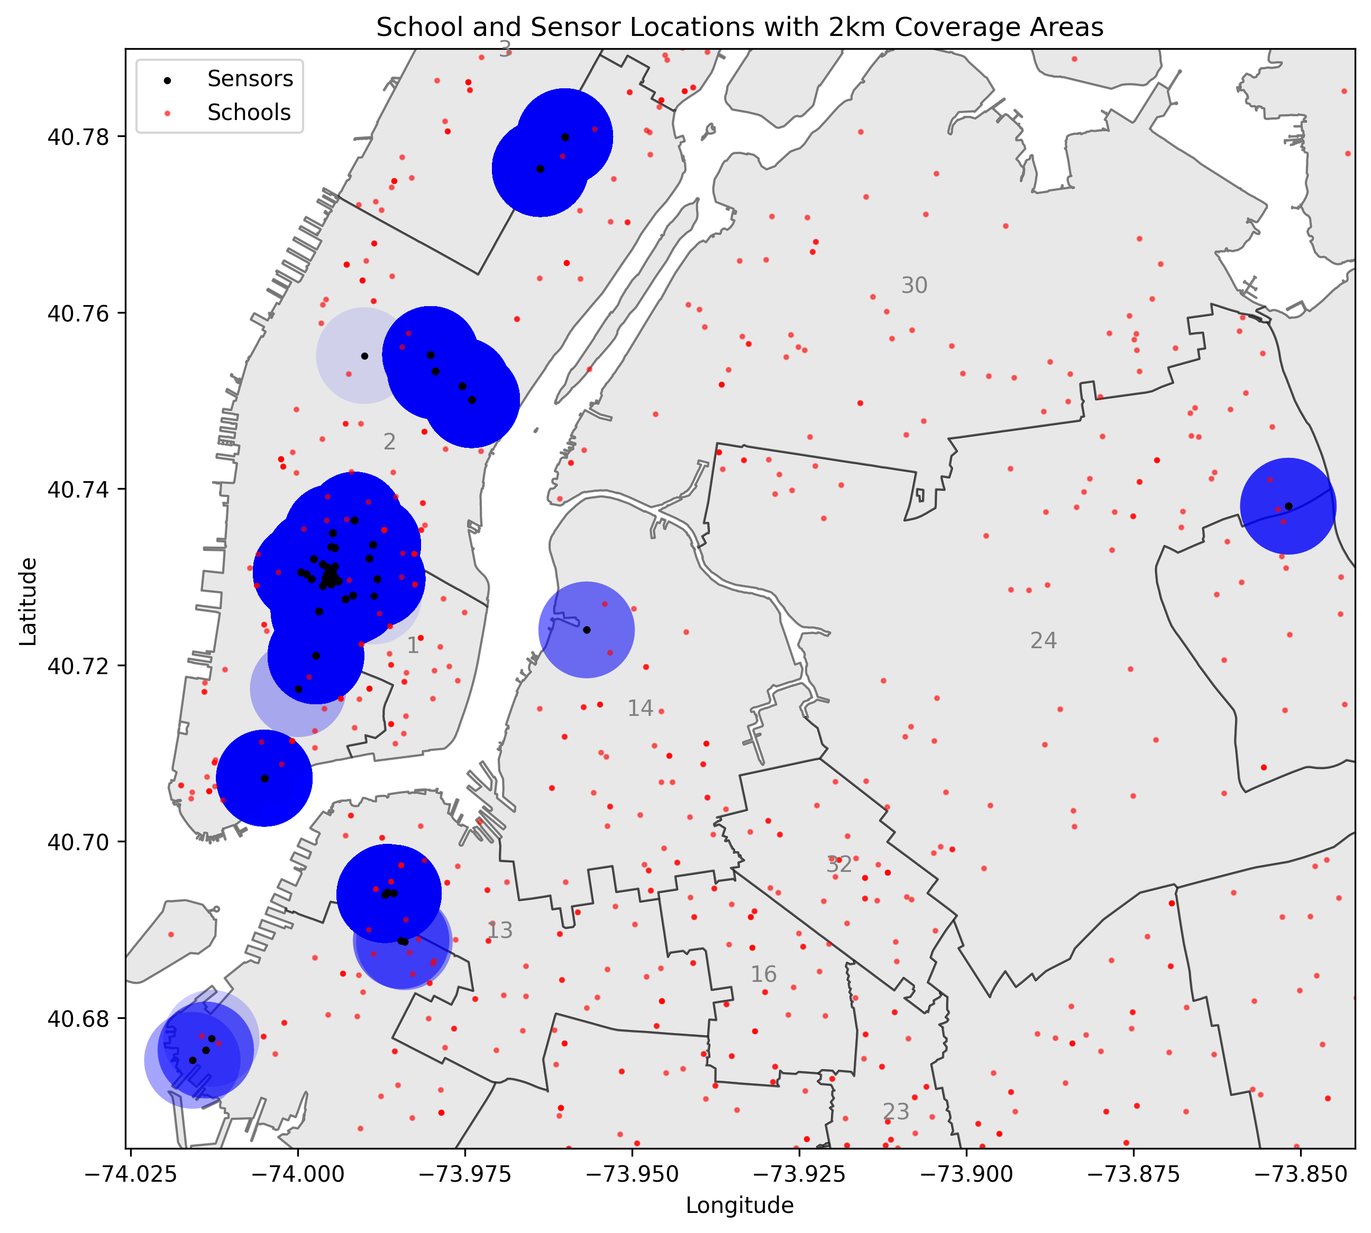
Notes:
I shrank the map using a bounding box containing all sensor points.
I used a 2km radius around each sensor to identify the schools that I would keep for analysis.
Any schools outside this buffer zone would be removed.
This time, sensors are black, and the 2km radius around each sensor is blue with an alpha of 0.1.
Some of the sensors in the data are rather close together, so darker blue zones indicate areas where there is overlapping sensor coverage.

Slide 8
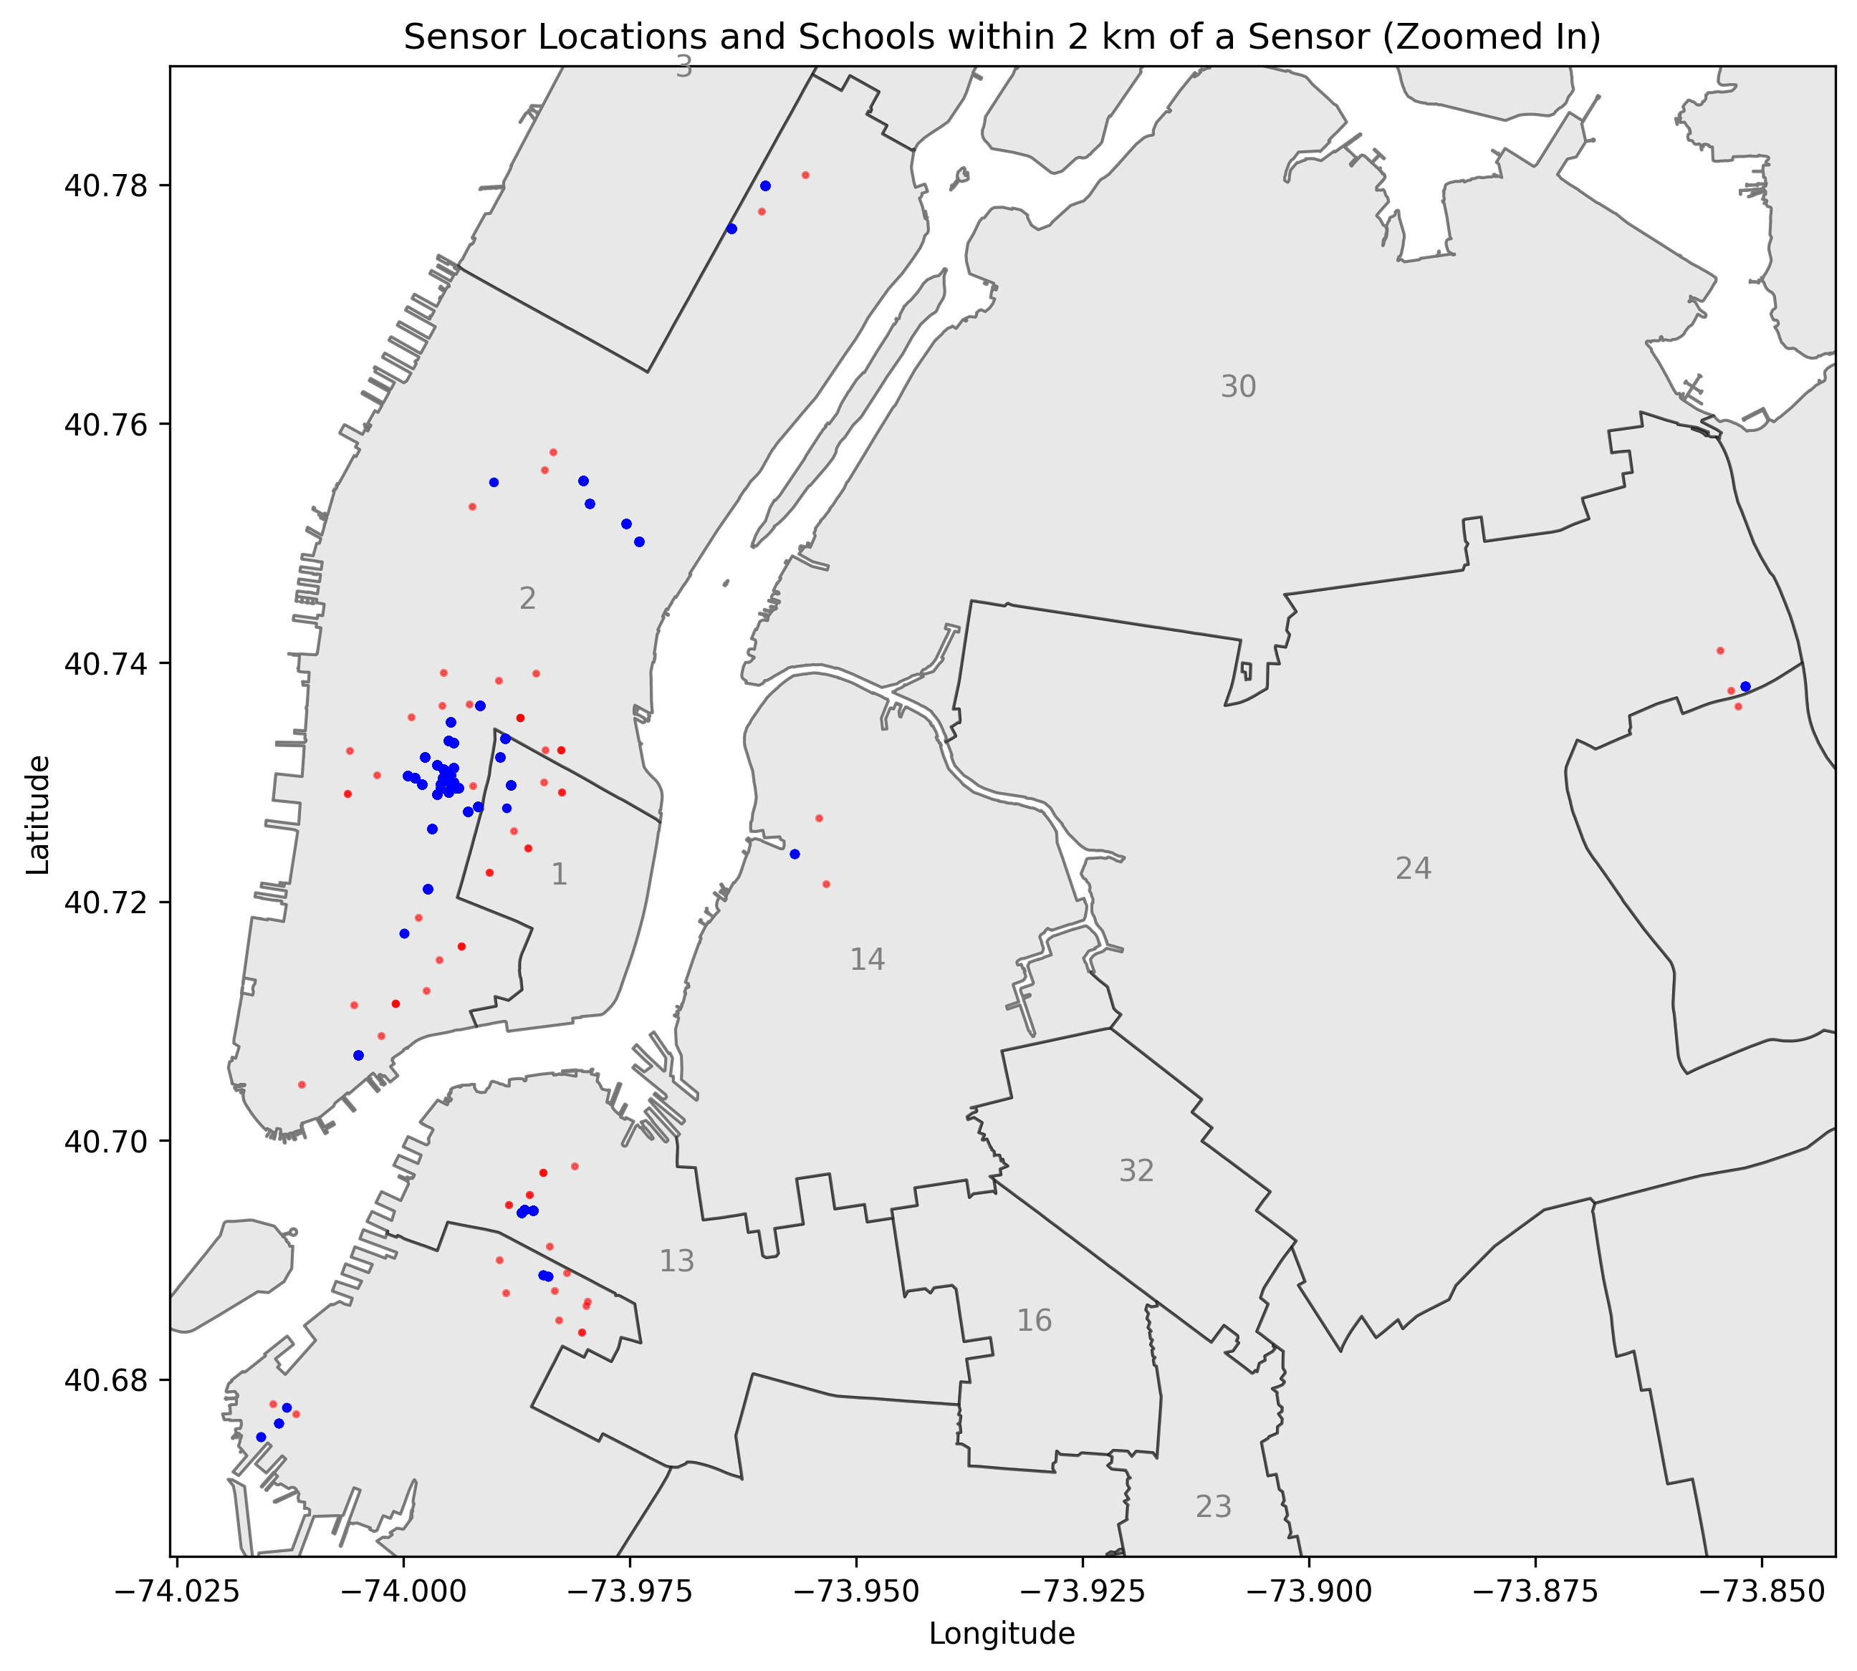
Notes:
Here is the final map of New York City after removing school locations that were outside the 2km range of the SONYC sensors.
Again, sensor locations are plotted in blue, while school locations are plotted in red.

Slide 9
Exploratory Data Analysis and Key Findings
How much does school achievement vary based on noise exposure?
Which sounds are most strongly associated with variation in school achievement?
Notes:
In my Exploratory Data Analysis phase, I was interested in answering the following questions…
How much does school achievement vary based on noise exposure?
Which sounds are most strongly associated with variation in school achievement?
To answer these questions, I looked at lower grades’ and high school grades’ achievement data separately.
I calculated the coefficient of variation per school, per achievement metric to see how strongly variations in achievement scores correlate with the presence of different types of noise.

Slide 10
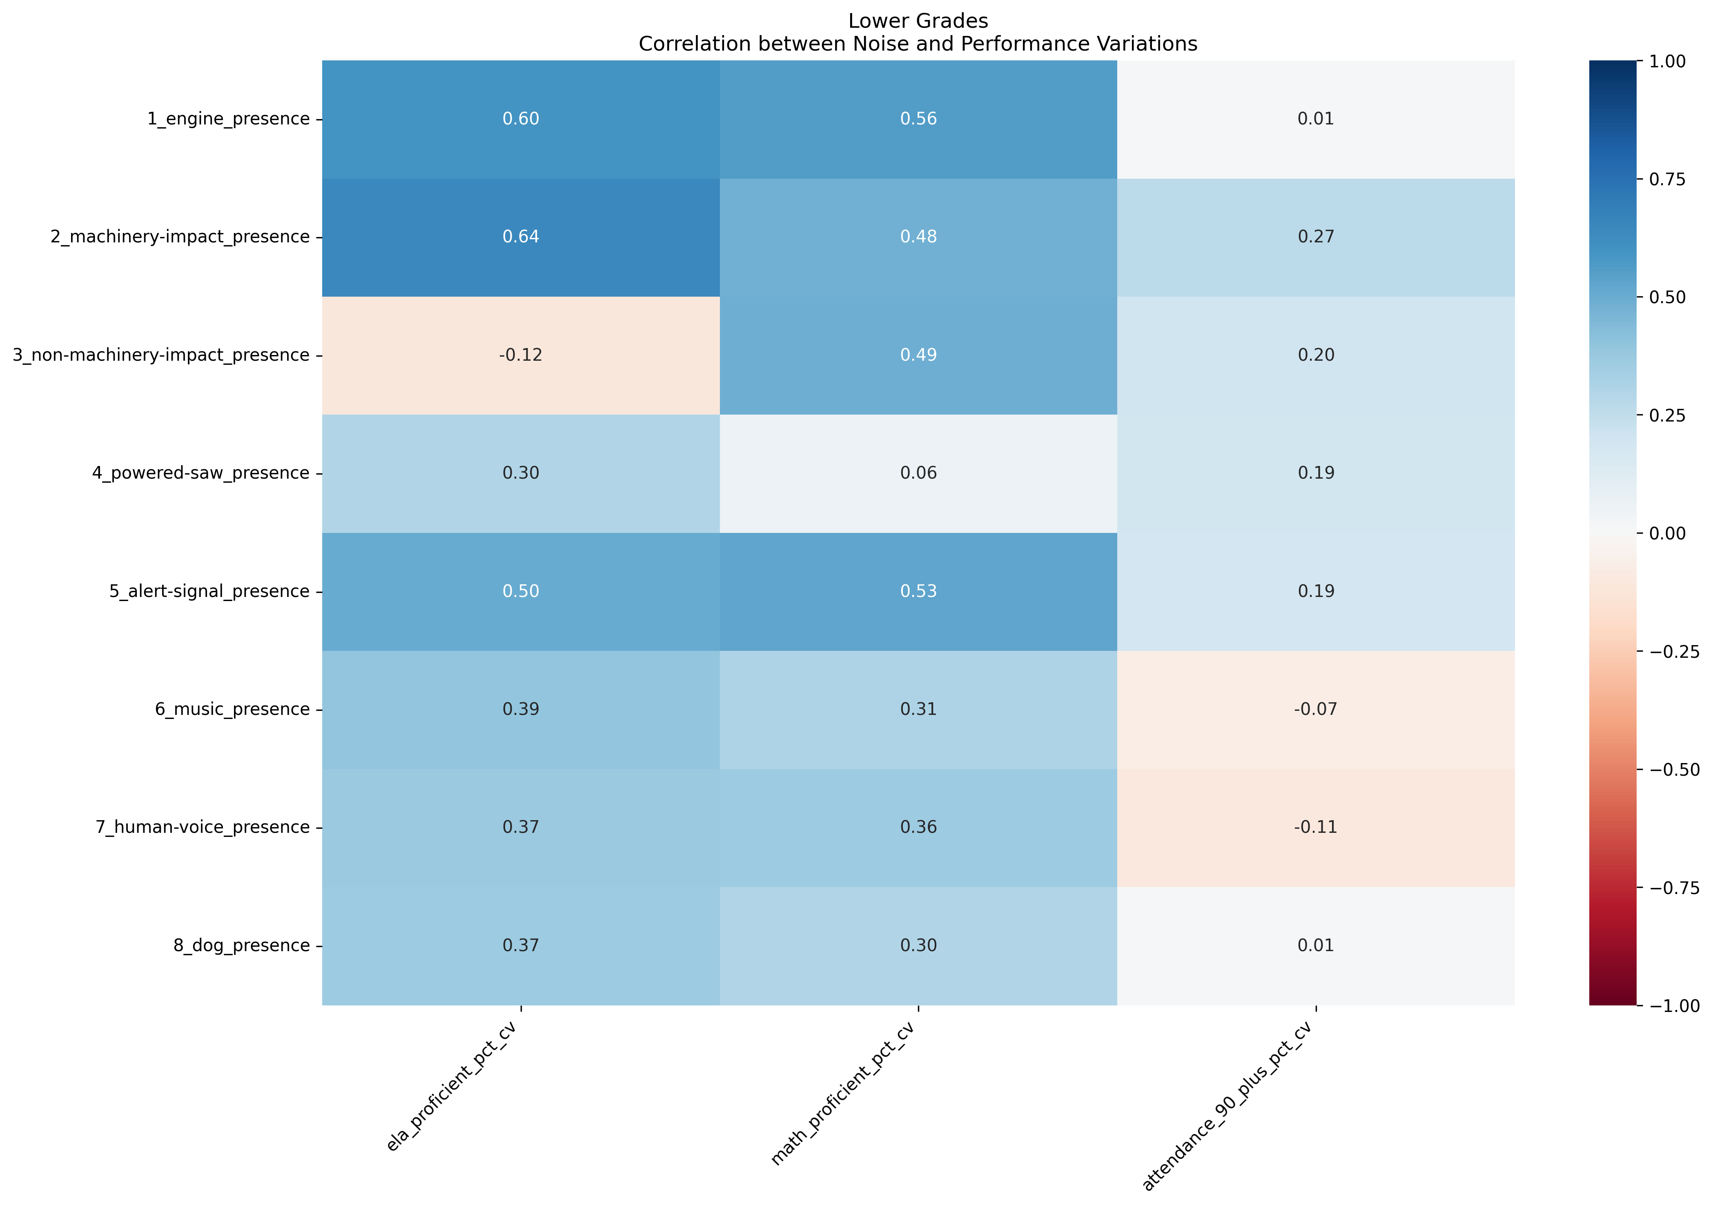
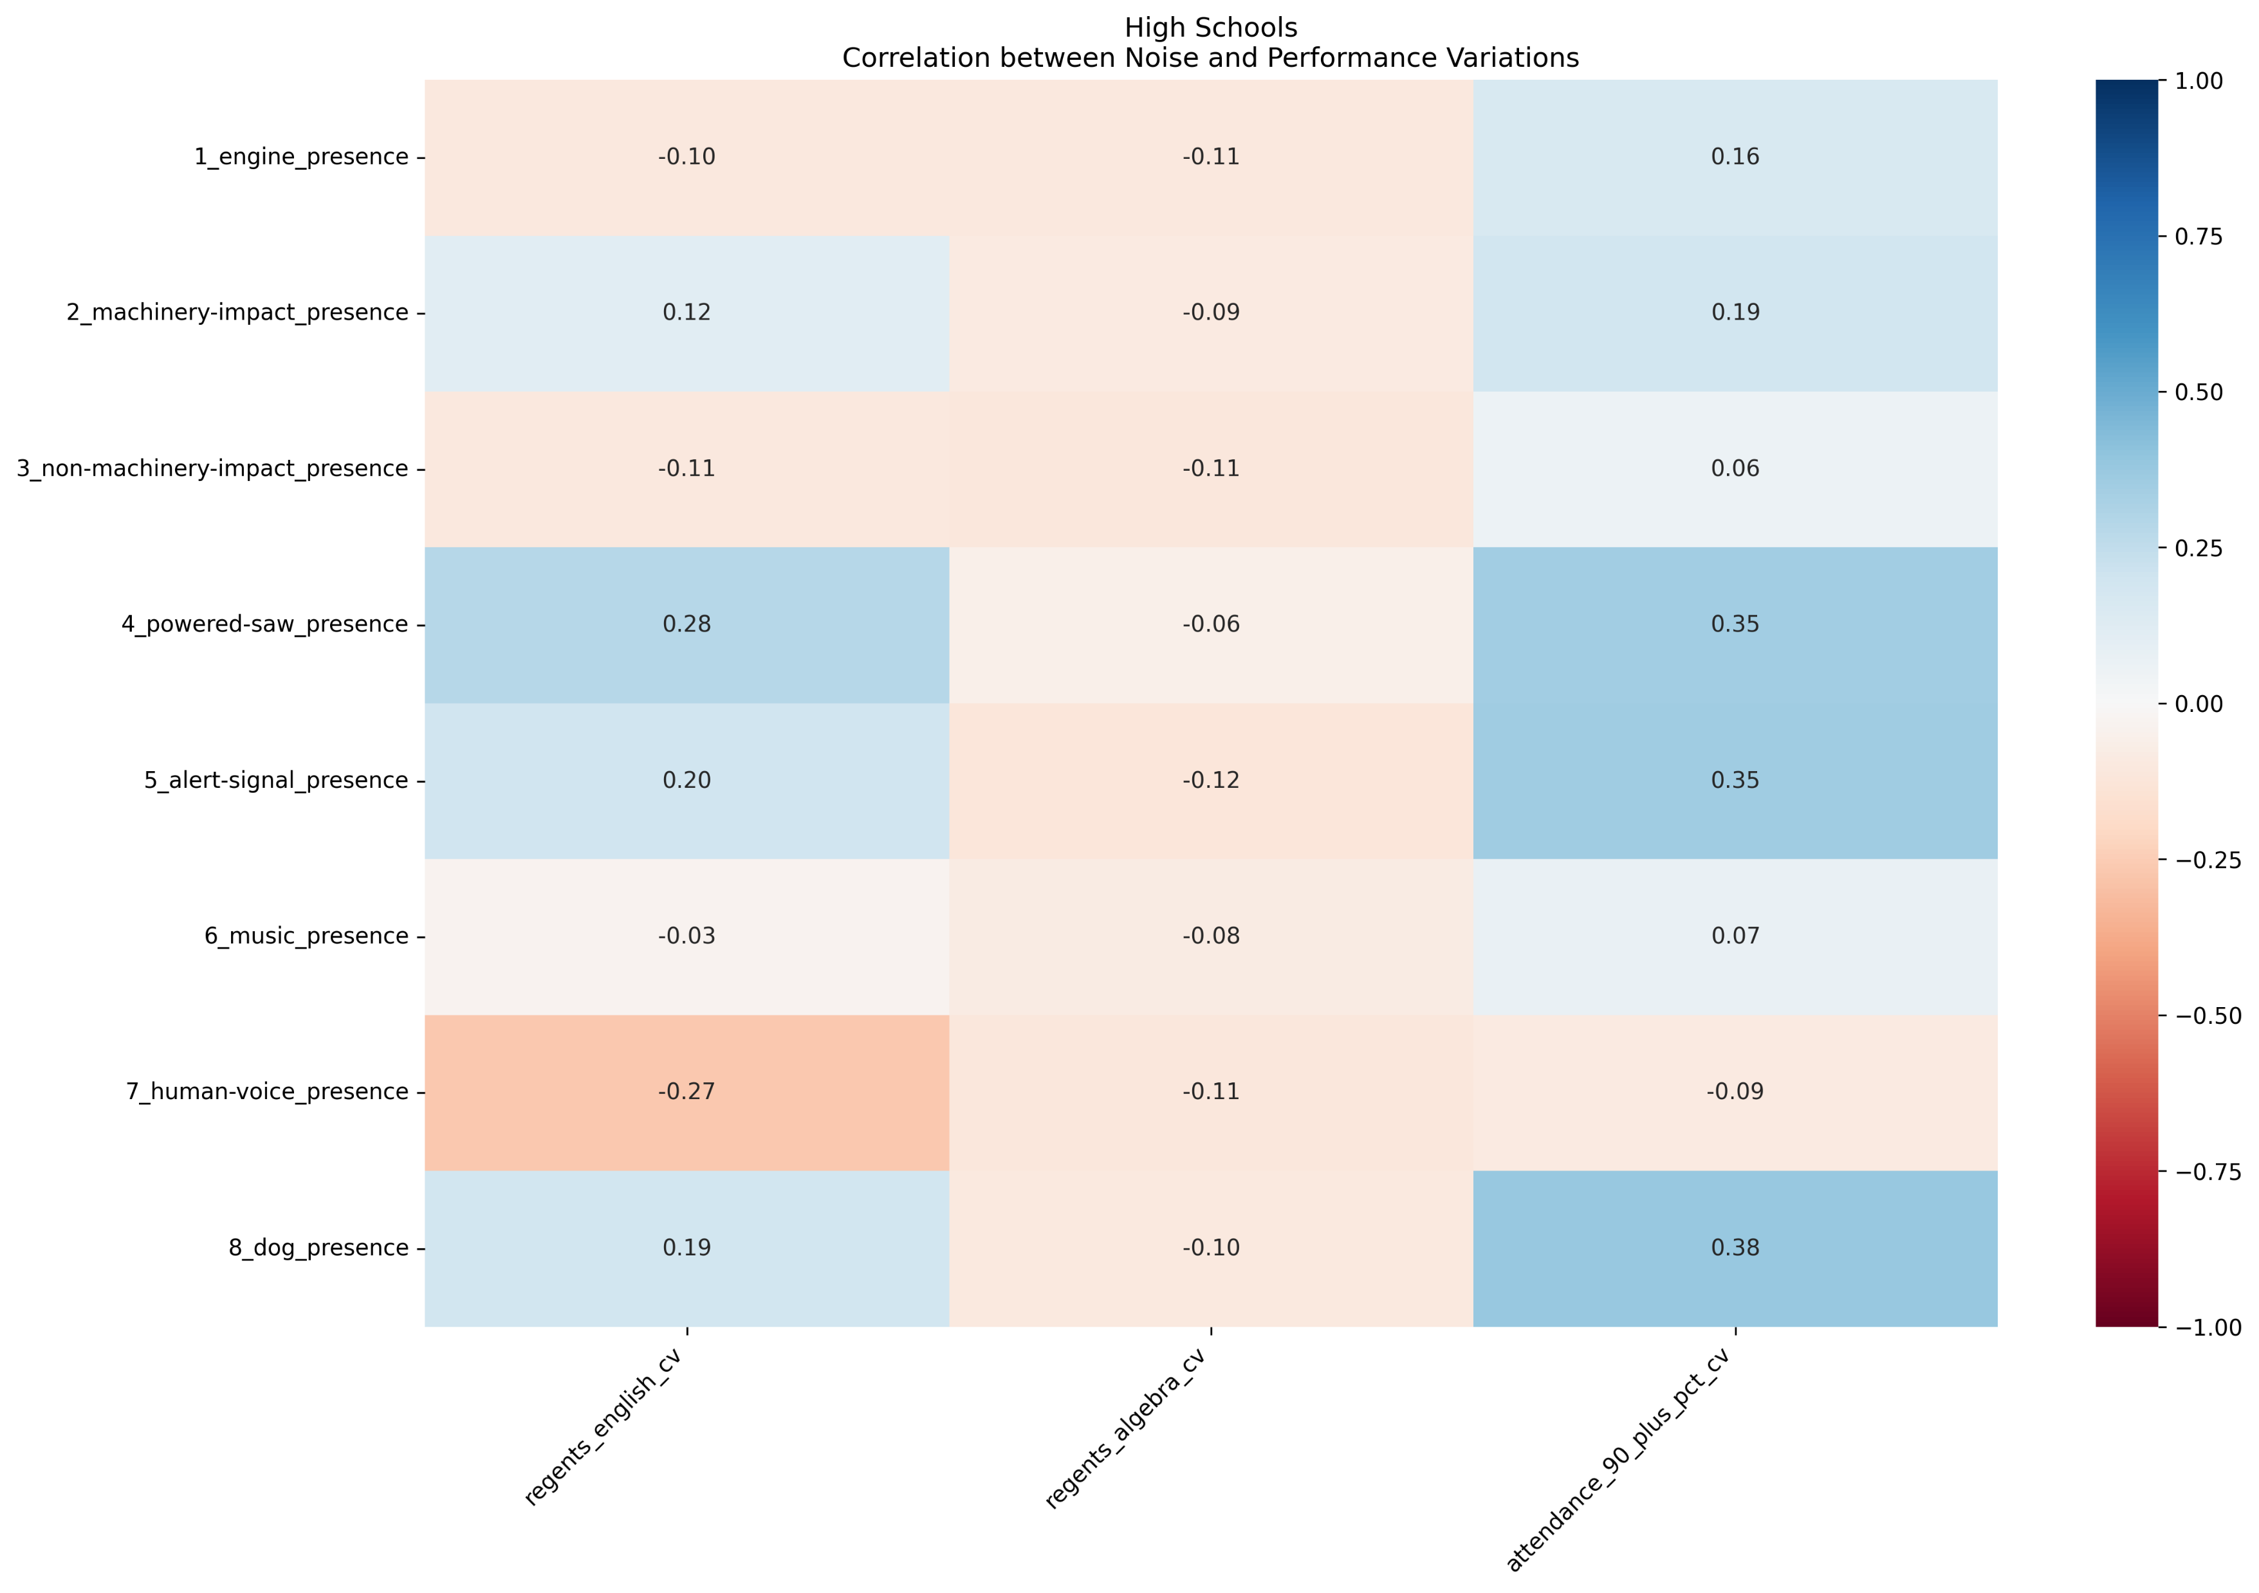
Notes:
This correlation heatmap shows the yearly changes in achievement metrics as a function of the presence of certain sounds.
Results for lower grades are on the left, while those for high school grades are on the right.
Achievement metrics being analyzed are standardized test scores in Math and English, as well as the percentage of students with over a 90% attendance rate.
This uncovered some interesting relationships between noise variation and school performance:
Lower grades show stronger noise-performance relationships than high schools.
ELA and Math proficiency variations are more strongly related to noise variations than attendance.
Mechanical noises (engine, machinery) show stronger correlations than human-generated sounds.
High schools seem more resilient to noise variation in terms of academic performance.
In short, elementary and middle school students seem more vulnerable to the effects of noise in their environment than high schoolers.

Slide 11
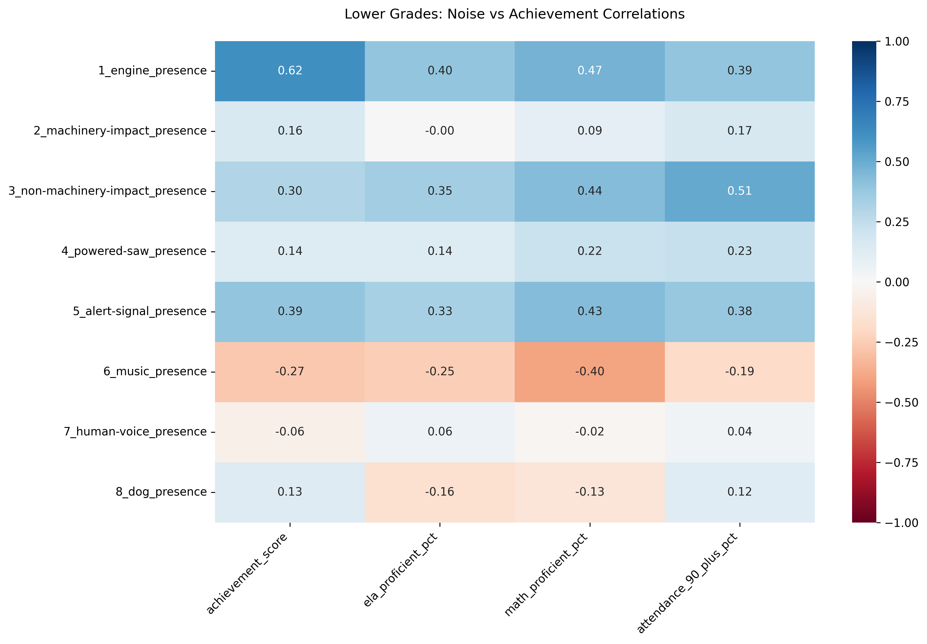
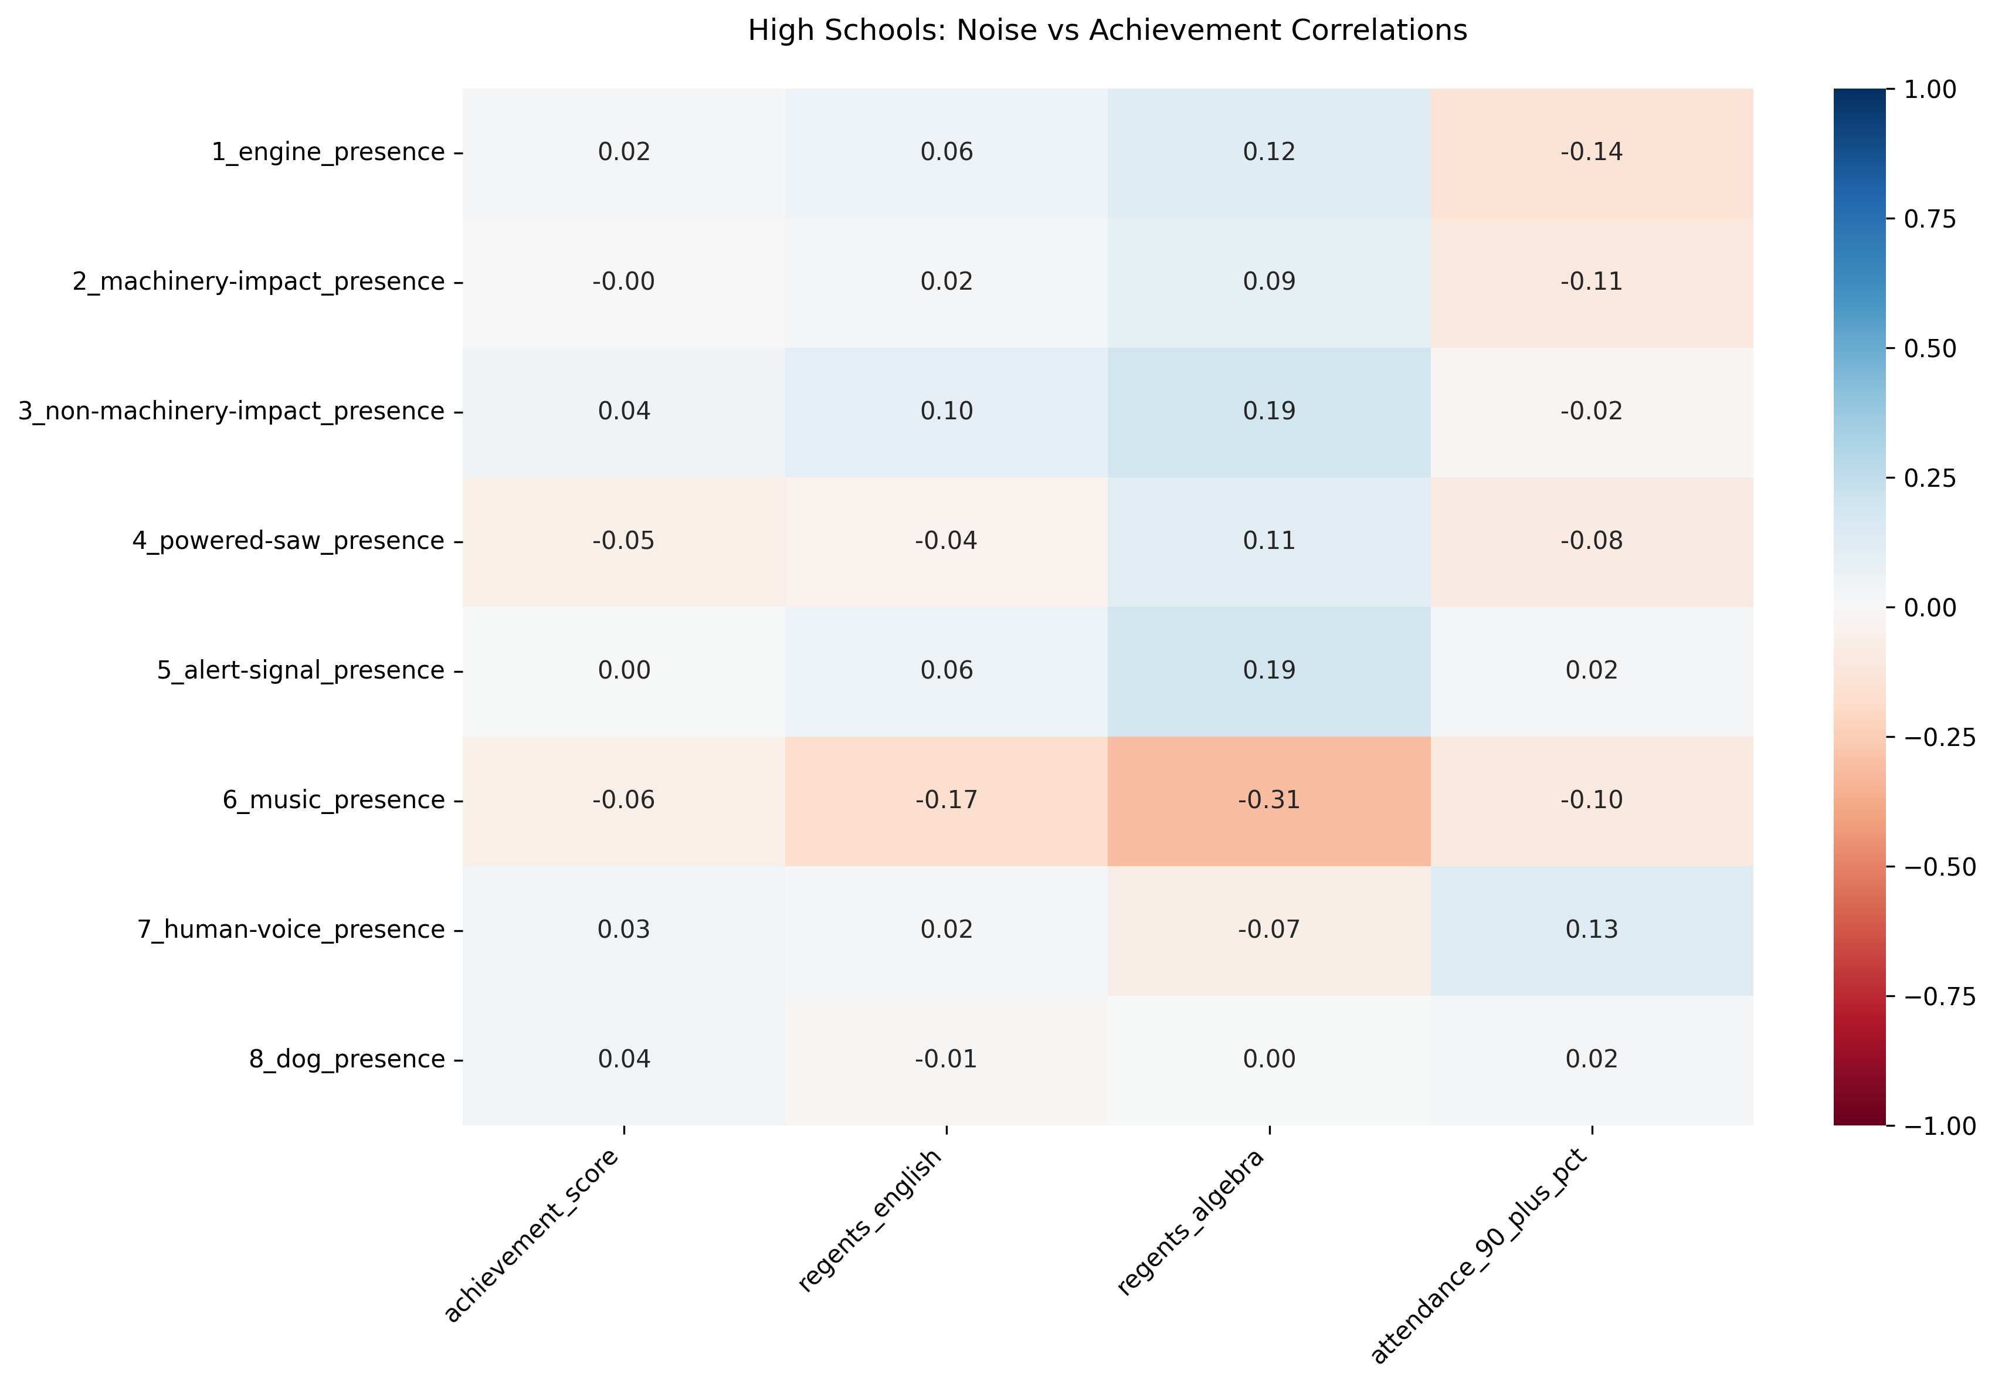
Notes:
This time, rather than looking at the coefficient of variation – or, how strongly year-over-year variations in achievement metrics are related to the presence of sound – we are looking at the direct correlation between achievement metrics and the presence of certain sounds.
This will answer the question of whether the presence of specific sounds has a positive or negative effect on student achievement.
Interestingly, for lower grades, our correlation map suggests that certain noises are positively correlated with some student achievement metrics.
Engine presence has a strong positive correlation with achievement score, which could suggest that schools in busier, more urban areas have better access to resources that enable student success.
Engine, non-machinery, and alert signal noises are positively correlated with ELA and Math proficiency, as well as high attendance.
However, music is very strongly negatively correlated with math proficiency. It is also negatively correlated with ELA proficiency and 90%+ attendance rates, although to a lesser degree.
For high schoolers, correlations of achievement with noise presence are weak across the board.
This suggests that high schoolers may be less sensitive to environmental noise than their younger counterparts. Correlation with achievement score is especially weak.
However, just as we saw with lower grades, music has the strongest negative correlation to achievement metrics in mathematics — this time, with Regents scores in algebra. Music is also negatively correlated with 90%+ attendance rates, as well as Regents scores in English.

Slide 12
Exploratory Data Analysis and Key Findings
Lower grades show stronger noise-performance relationships than high schools.
Music is negatively correlated with achievement metrics.
Notes:
Lower grades show stronger noise-performance relationships than high schools, indicating that lower grades might be more sensitive to noise variation.
While this might be due to differences in sample size, this could also possibly be due to students being at different stages of brain development.
More mature students might have stronger coping mechanisms and might be more resilient to auditory distractions in the academic environment.
For both lower grades and high school, the presence of music in the academic environment is negatively correlated with achievement metrics.

Slide 13
Exploratory Data Analysis and Key Findings
K-Means clustering used to identify noise exposure patterns in schools
First Principal Component (PC1)
Strong positive correlations:
Machinery-impact (0.437)
Alert-signal (0.412)
Engine (0.374)
Powered saw (0.359)
Strong negative correlations:
Human voice (-0.403)
Music (-0.296)
Second Principal Component (PC2):
Strong positive correlations:
Dog (0.581)
Non-machinery impact (0.478)
Human voice (0.294)
Strong negative correlations:
Music (-0.531)
Powered saw (-0.225)
Notes:
As an additional part of my Exploratory Data Analysis Process, I also performed K-Means clustering to explore whether schools naturally group together based on their noise exposure patterns.
This analysis provided valuable context about the types of noise environments that exist across schools, revealing patterns that would not have been apparent when looking at individual noise types in isolation.
What I found was that:
PC1 separated mechanical noise from human-generated noise.
PC2 separated uncontrolled environmental noise from intentional noise.

Slide 14
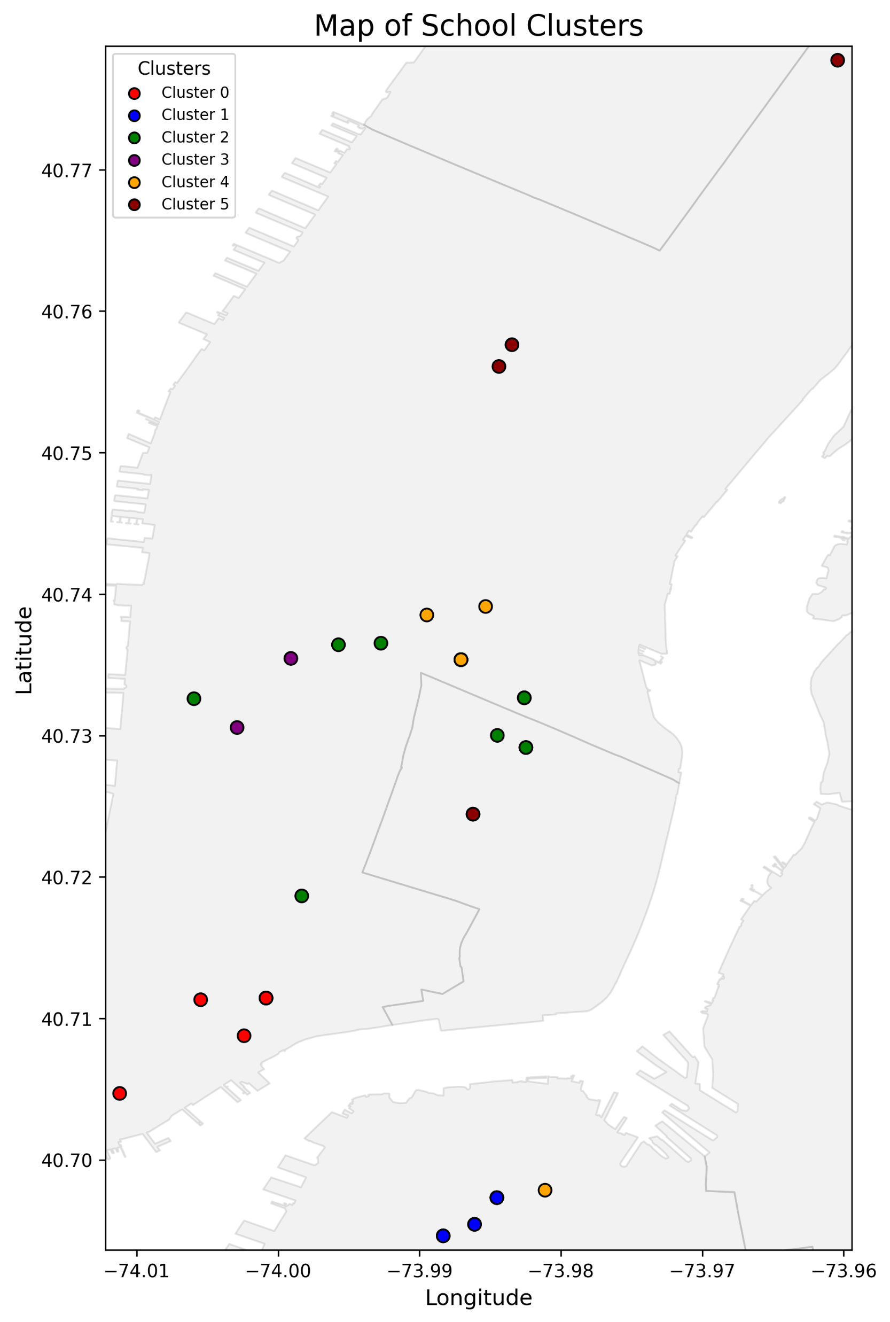
Notes:
Through K-Means analysis, I identified 6 distinct clusters.
On this map, clusters are identified by color.
This makes sense that schools with similar noise profiles are close to each other, since schools within close proximity will be exposed to the same sounds.

Slide 15
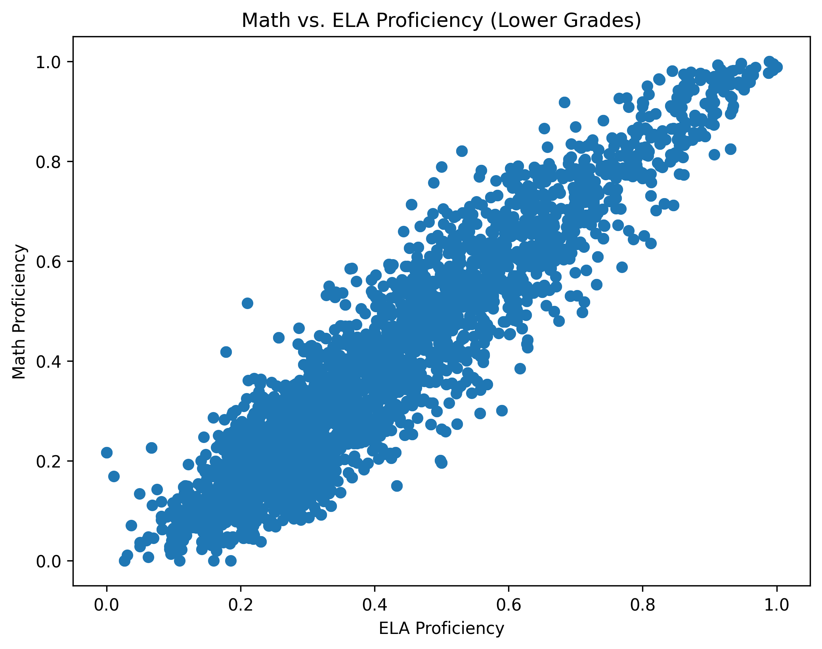
Modeling
Focused on lower grades
Target variable: Combined metric using Math and ELA proficiency
Trained and evaluated three different classification models:
Logistic Regression
Random Forest Classifier
Support Vector Machine
Notes:
Since I learned in my Exploratory Data Analysis that lower grades have stronger noise-performance relationships, I focused on creating models for lower grades rather than for both lower grades and high school.
I found in my Exploratory Data Analysis that there was a nearly 1:1 correlation between ELA and Math proficiency (actual correlation was 0.94 for Math to 1.00 for ELA), suggesting that I could use a combined metric of these two proficiency scores as a target variable for my machine learning models.
Trained and evaluated three different classification models:
Logistic Regression
Random Forest Classifier
Support Vector Machine

Slide 16
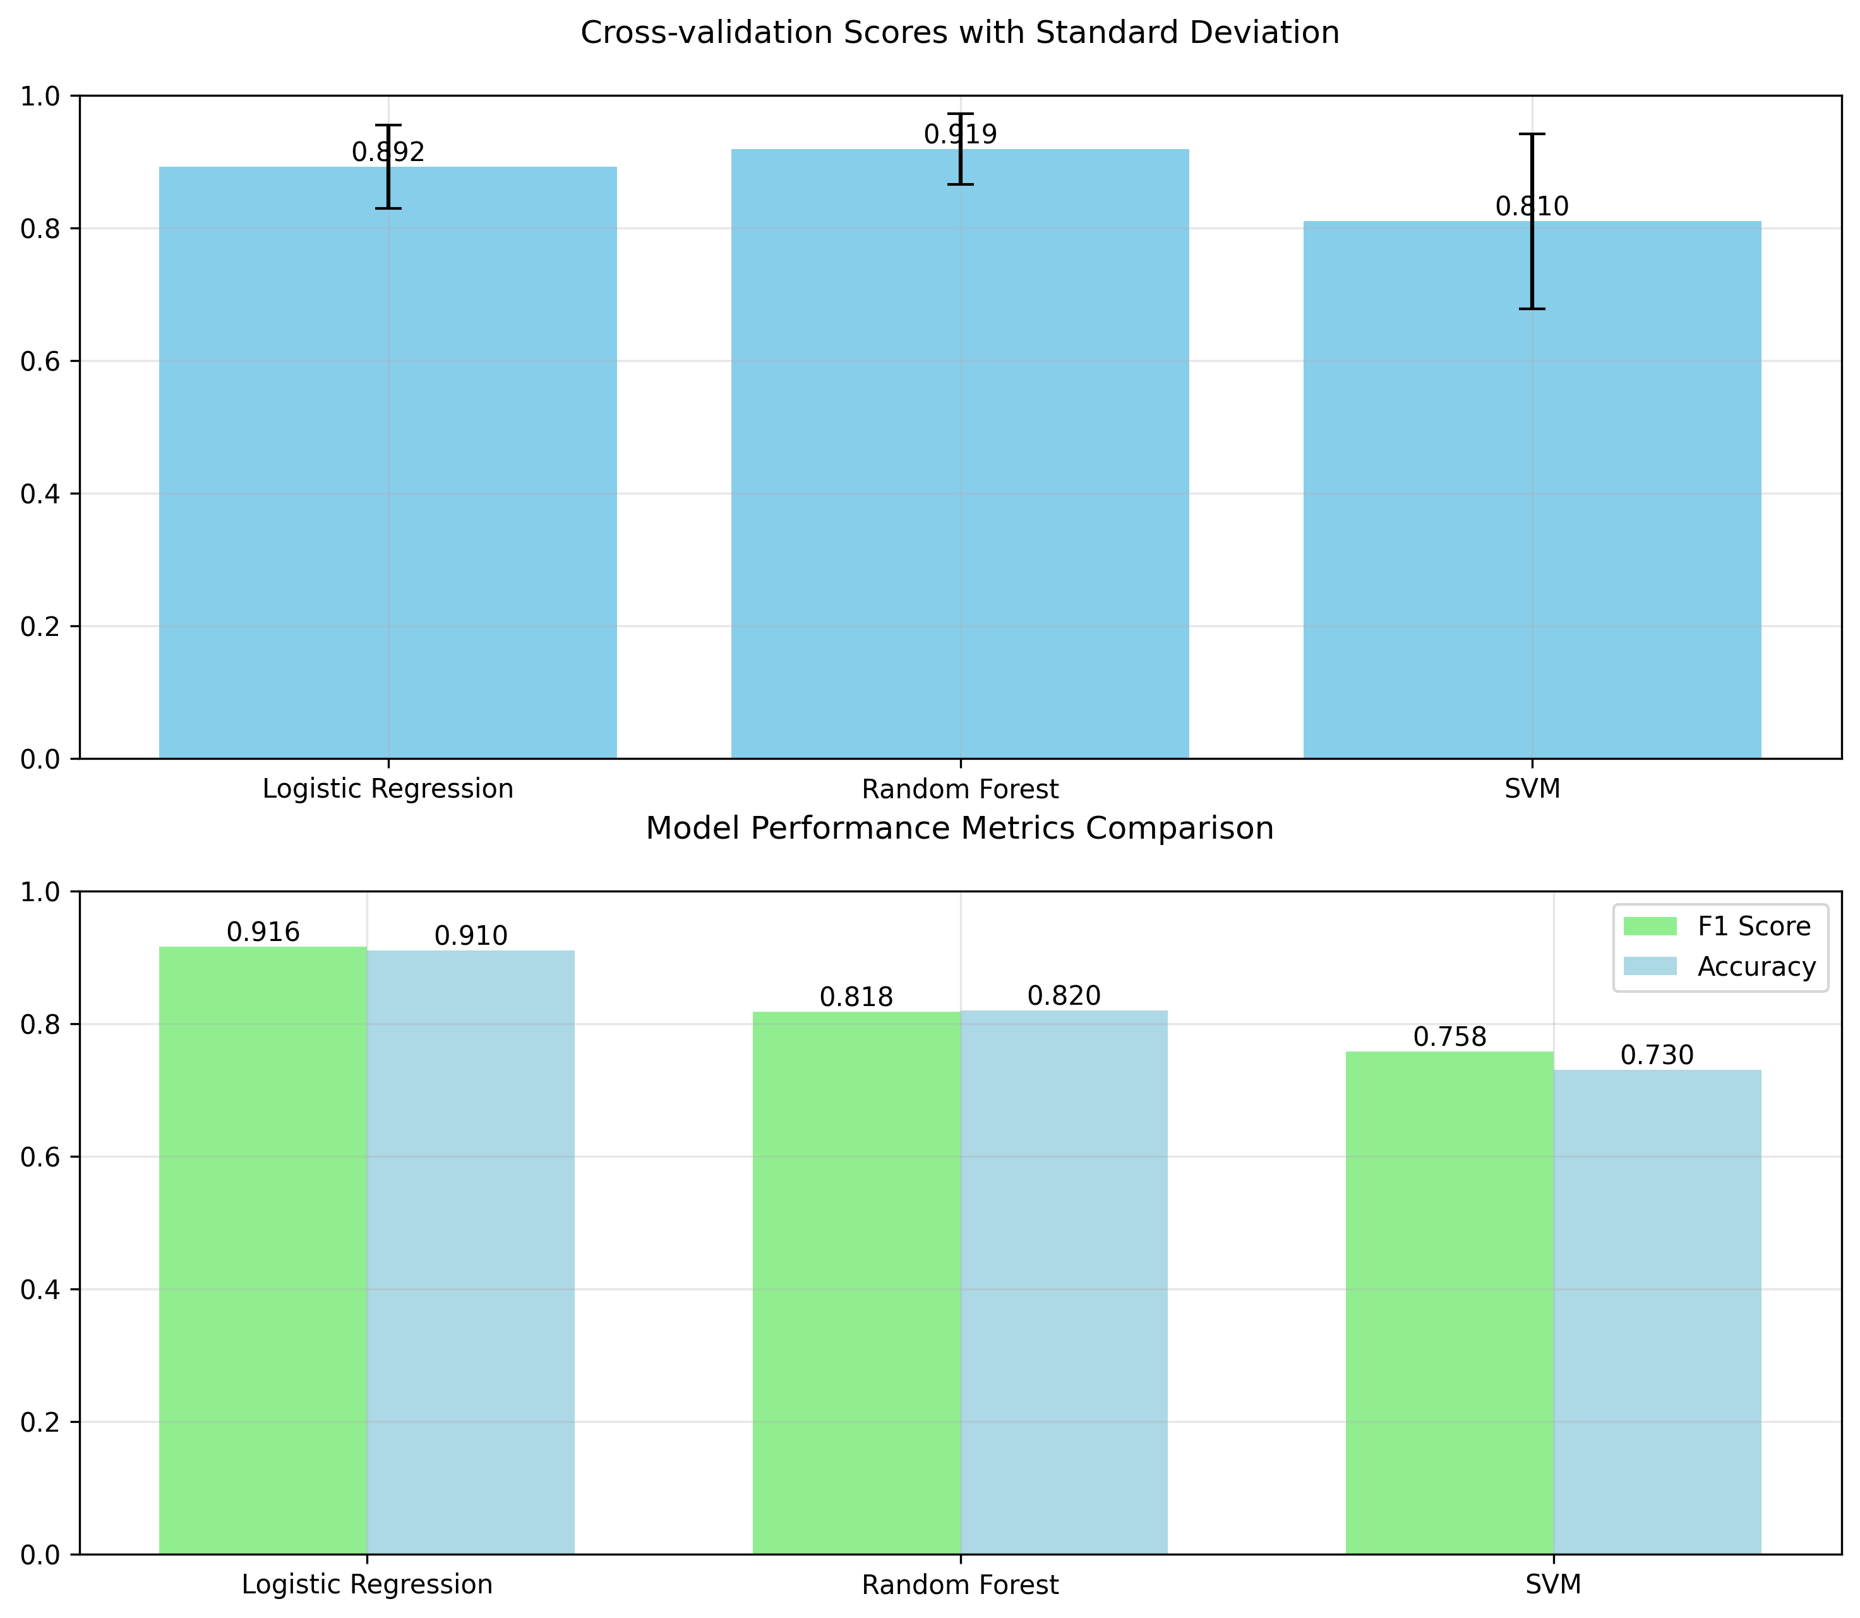
Notes:
While the Random Forest model showed the highest cross-validation score (0.919) and more balanced performance between classes, it did not quite match the Logistic Regression model’s overall performance.
Logistic Regression model since it outperformed Random Forest and SVM on F1 scores and accuracy.
Cross-validation score of 0.892 shows robust performance
F1 Score of 0.916 indicates balanced predictions
Accuracy of 0.91 demonstrates reliable results

Slide 17
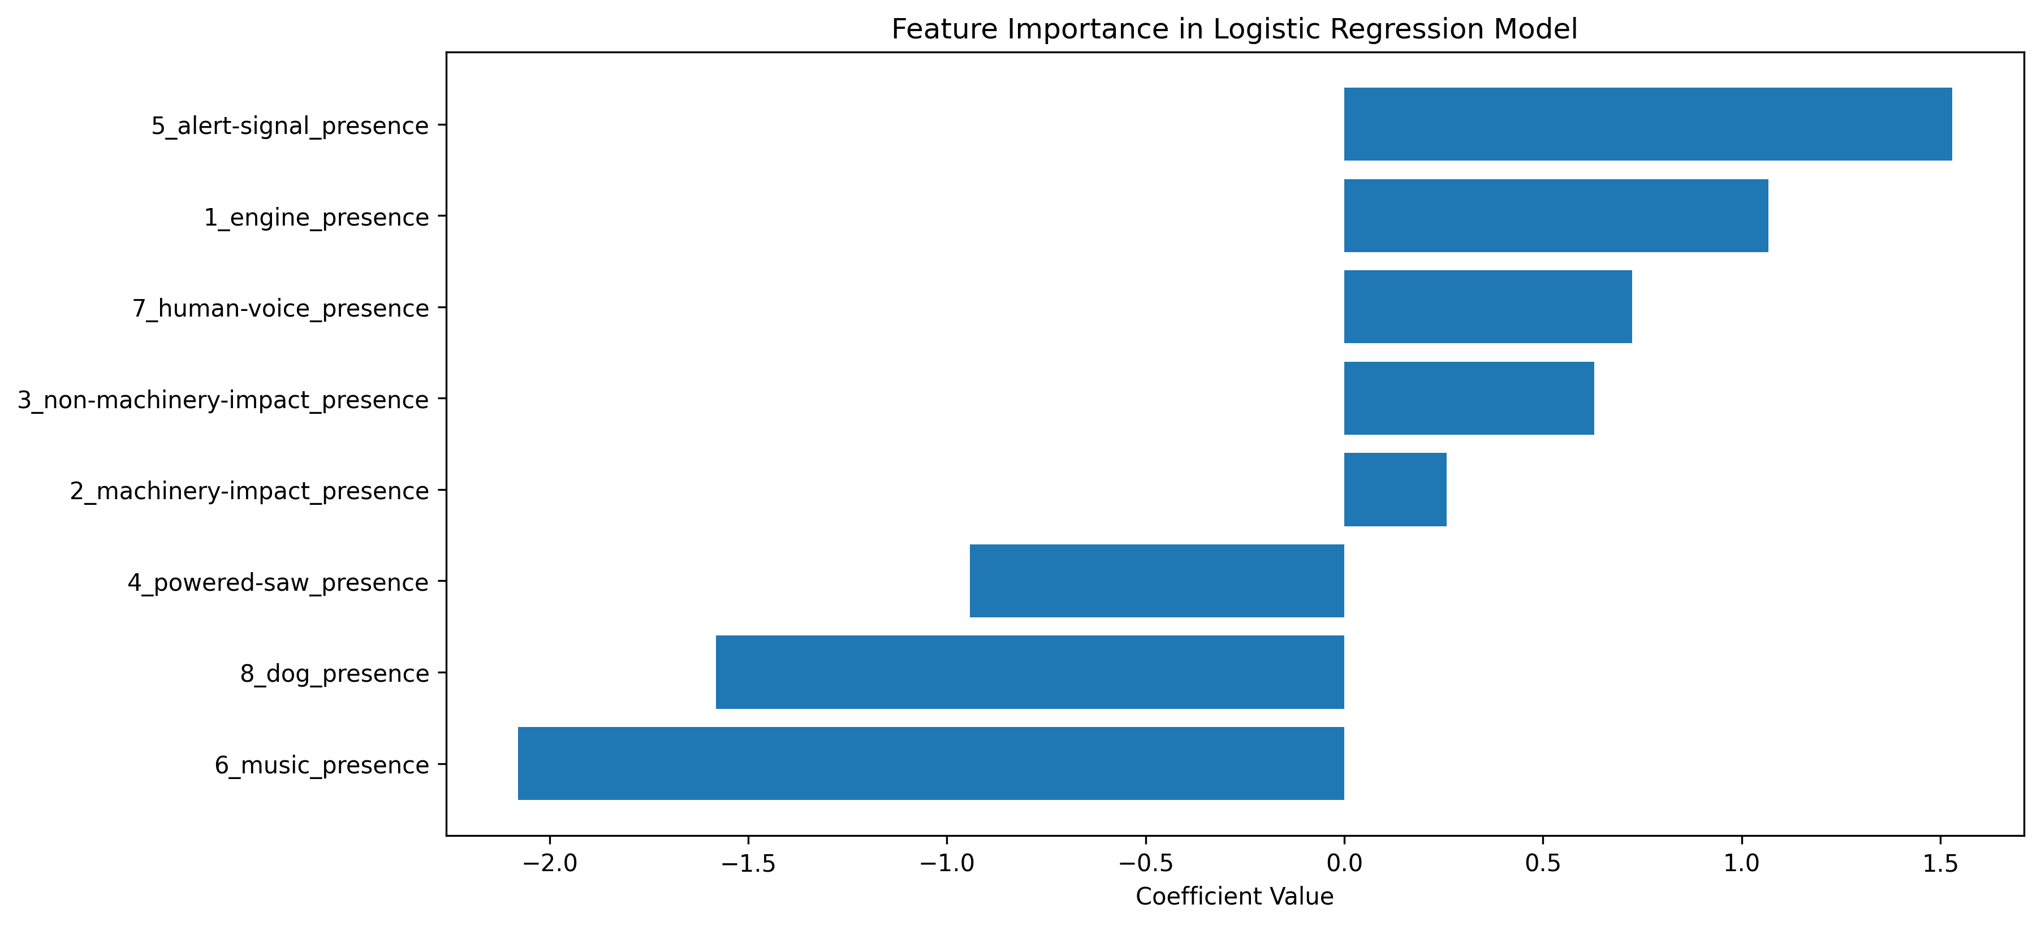
Analysis Results
Notes:
Our analysis of the Logistic Regression model reveals several interesting patterns in how different types of environmental noise relate to academic achievement. The model identified varying strengths and directions of relationships between noise types and student performance.
Music and dog sounds showed the strongest overall impacts - increased presence of these noise types was associated with lower achievement.
Music had the strongest impact (coefficient: 2.08, odds ratio: 0.12), followed by dog presence (coefficient: 1.58, odds ratio: 0.21).
This suggests that schools with higher levels of these noise types are more likely to fall into the lower-achieving category.
Conversely, alert signals and engine noise showed strong positive associations with achievement.
Alert signals had the strongest positive relationship (coefficient: 1.53, odds ratio: 4.62), followed by engine noise (coefficient: 1.07, odds ratio: 2.91).
Human voices, non-machinery impact, and machinery impact also showed positive, though weaker, relationships with achievement.

Slide 18
Recommendations
Immediate Actions
Provide noise reduction equipment (headphones, earplugs) during independent study
Prioritize noise mitigation in elementary grades where impacts are strongest
Infrastructure Planning
Focus sound isolation efforts on music-related noise, particularly near entertainment venues
Policy Development
Schedule noise-sensitive activities (testing, focused work) during quieter periods
Notes:
Immediate Actions
Provide noise reduction equipment during independent study
Allows individual students to control their noise exposure
Particularly effective during reading or focused work periods
Can be implemented quickly and at relatively low cost
Gives students agency in managing their learning environment
Could start with pilot program in most affected classrooms
Prioritize noise mitigation in elementary grades
Our analysis showed stronger noise impacts on younger students
Early intervention may prevent cumulative effects
Younger students have fewer developed coping strategies
Focus resources where they'll have the greatest impact
Can be implemented gradually, starting with most affected schools
Infrastructure Planning
Focus sound isolation efforts on music-related noise
Our model showed strongest negative correlation with music (-2.080)
Particularly important near entertainment venues
Consider window upgrades and wall insulation
Create buffer zones where possible
Work with venues on scheduling and sound management
Policy Development
Schedule noise-sensitive activities during quieter periods
Use noise pattern data to identify optimal testing times
Coordinate standardized testing with known quiet periods
Schedule focused work during lower noise windows
Consider flexible scheduling for noise-sensitive activities
Develop protocols for when noise levels exceed thresholds

Slide 19
Future Directions and Improvements
Practical Considerations
Implementation costs vary significantly by intervention type
Schools have varying infrastructure limitations
Potential Improvements
Collect student and teacher feedback on noise impact
Track intervention outcomes systematically
Future Research
Long-term study of noise reduction interventions
Integration with SONYC’s enhanced sensor network
Cross-city comparisons of urban noise patterns
Notes:
Practical Considerations
Implementation costs vary significantly by intervention type
Simple solutions like providing headphones are relatively low-cost and quick to implement
Building modifications like soundproofing require substantial investment
Schools need to prioritize interventions based on available budget and expected impact
Some solutions might qualify for environmental improvement grants or city funding
Schools have varying infrastructure limitations
Older buildings may have structural constraints that limit modification options
Some schools share buildings or are near immovable noise sources
Available space for creating buffer zones varies by location
Historical building designations may restrict modification options
Potential Improvements
Collect student and teacher feedback on noise impact
Develop surveys to gather qualitative data about noise experiences
Track student self-reported concentration levels throughout the day
Document teacher observations about noise effects on different activities
Create feedback channels for reporting acute noise issues
Track intervention outcomes systematically
Establish baseline measurements before implementing changes
Monitor academic performance changes after interventions
Document which solutions work best for different noise types
Create standardized reporting system for noise-related issues
Future Research
Long-term study of noise reduction interventions
Follow schools over multiple years after implementing changes
Compare different intervention strategies across similar schools
Study lasting effects on student performance
Evaluate cost-effectiveness of different solutions over time
Integration with SONYC's enhanced sensor network
Take advantage of continuous monitoring capabilities
Access more detailed noise type classification
Get real-time data for immediate intervention
Study patterns across different times and seasons
Cross-city comparisons of urban noise patterns
Compare NYC findings with other major urban school districts
Identify successful strategies from other cities
Study how different urban layouts affect school noise exposure
Learn from diverse approaches to noise management

